Slide 1
Linear Regression
The Calculus Optimization Perspective

Slide 2
Outline
The Model Error Function
Minimizing Model Error Using Partial Derivatives

Slide 3
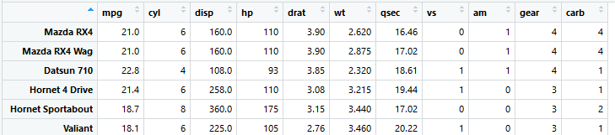
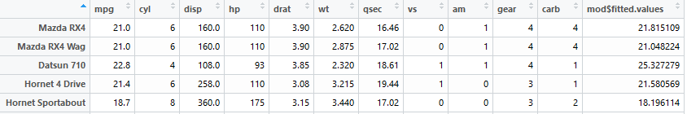
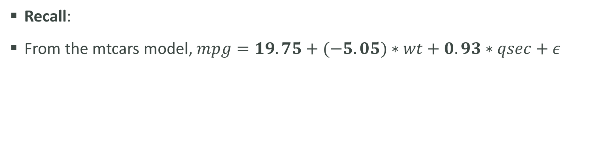
The Model Error Function
Recall:
From the mtcars model, $mpg=19.75+(−5.05)∗wt+0.93∗qsec+ε$
$$y=β_{0}+β_{1}x_{1}+β_{2}x_{2}+…+β_{k}x_{k}+ε$$

Slide 4
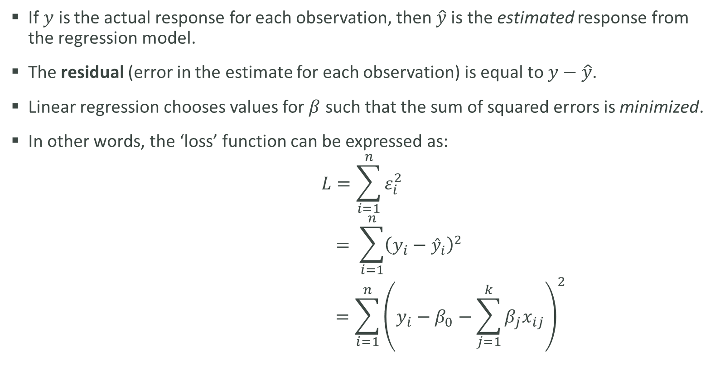
The Model Error Function
If $y$ is the actual response for each observation, then $\hat{y}$is the estimated response from the regression model.
The residual (error in the estimate for each observation) is equal to $y−\hat{y}$.
Linear regression chooses values for $β$ such that the sum of squared errors is minimized.
In other words, the ‘loss’ function can be expressed as:
$$L=\sum_{i=1}^{n}{ε_{i}^{2}}$$
$$= \sum_{i=1}^{n}{{\left(y_{i}−{\hat{y}}_{i}\right)}^{2}}$$
$$=\sum_{i=1}^{n}{{\left(y_{i}−β_{0}−\sum_{j=1}^{k}{β_{j}x_{ij}}\right)}^{2}}$$

Slide 5
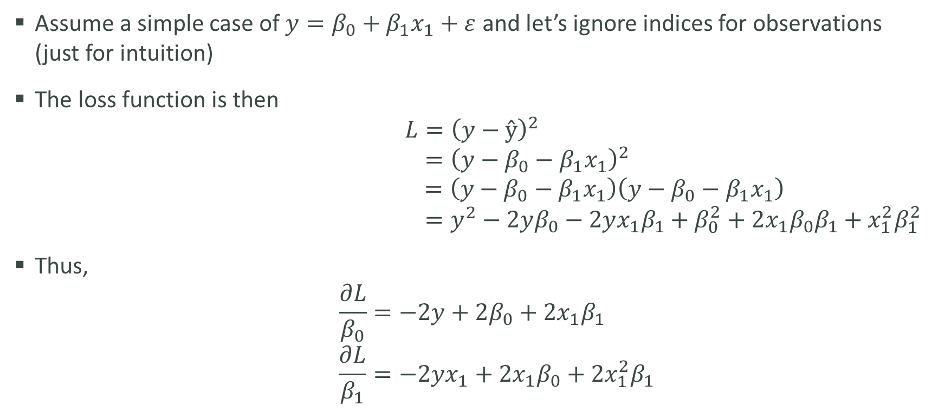
Minimizing Model Error Using Partial Derivatives
Assume a simple case of $y=β_{0}+β_{1}x_{1}+ε$ and let’s ignore indices for observations (just for intuition)
The loss function is then
$$L={\left(y−ŷ\right)}^{2}$$
$$={\left(y−β_{0}−β_{1}x_{1}\right)}^{2}$$
$$=\left(y−β_{0}−β_{1}x_{1}\right)\left(y−β_{0}−β_{1}x_{1}\right)$$
$$=y^{2}−2yβ_{0}−2yx_{1}β_{1}+β_{0}^{2}+2{x_{1}β}_{0}β_{1}+x_{1}^{2}β_{1}^{2}$$
Thus,
$$\frac{∂L}{β_{0}}=−2y+2β_{0}+2x_{1}β_{1}$$
$$\frac{∂L}{β_{1}}=−2yx_{1}+2x_{1}β_{0}+2x_{1}^{2}β_{1}$$

Slide 6
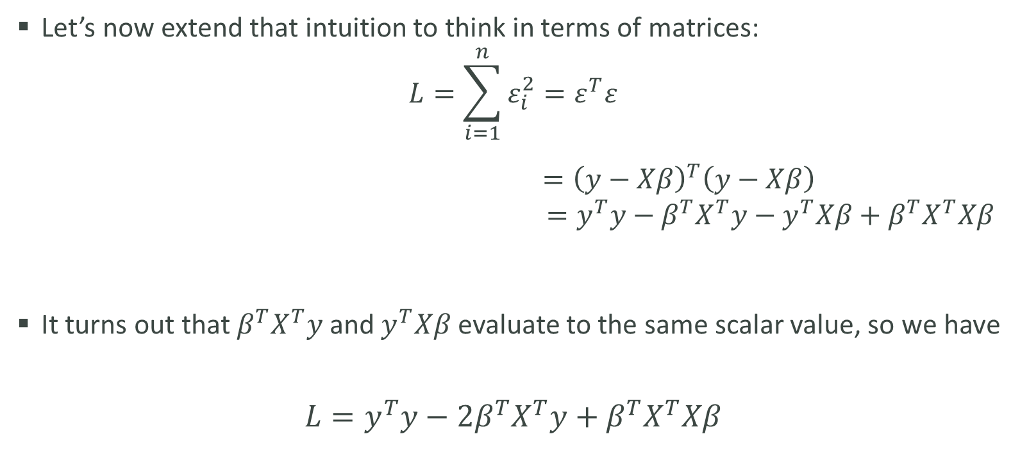
The Model Error Function
Let’s now extend that intuition to think in terms of matrices:
$$L=\sum_{i=1}^{n}{ε_{i}^{2}}=ε^{T}ε$$
$={\left(y−Xβ\right)}^{T}\left(y−Xβ\right)$
$$=y^{T}y−β^{T}X^{T}y−y^{T}Xβ+β^{T}X^{T}Xβ$$
It turns out that $β^{T}X^{T}y$ and $y^{T}Xβ$ evaluate to the same scalar value, so we have
$$L=y^{T}y−2β^{T}X^{T}y+β^{T}X^{T}Xβ$$

Slide 7
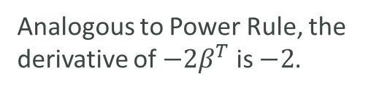
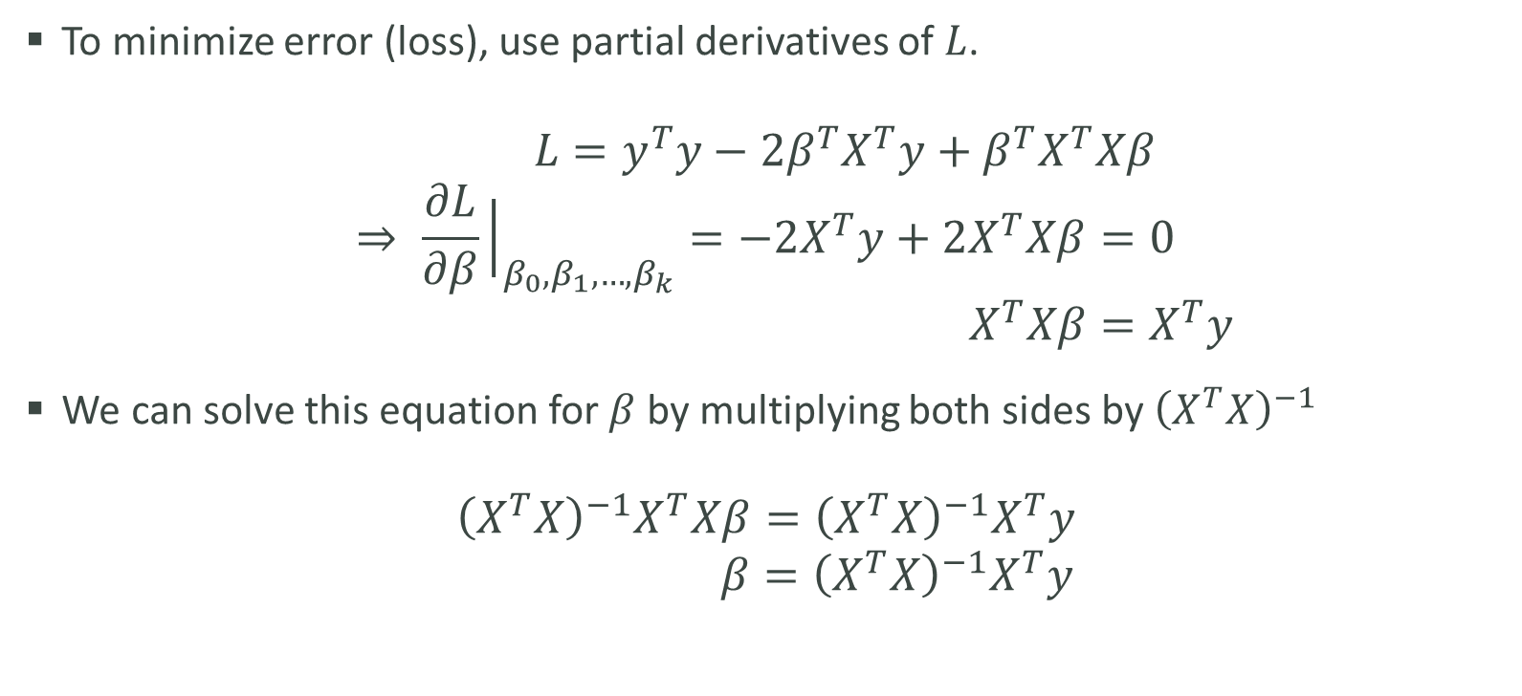
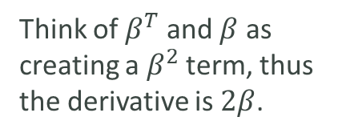
Minimizing Model Error Using Partial Derivatives
To minimize error (loss), use partial derivatives of $L$.
$$L=y^{T}y−2β^{T}X^{T}y+β^{T}X^{T}Xβ$$
$$⇒ \frac{∂L}{∂β}{\left.​\right|}_{β_{0}, β_{1},…,β_{k}}=−2X^{T}y+2X^{T}Xβ=0$$
$$X^{T}Xβ=X^{T}y$$
We can solve this equation for $β$ by multiplying both sides by ${\left(X^{T}X\right)}^{−1}$
$${\left(X^{T}X\right)}^{−1}X^{T}Xβ={{\left(X^{T}X\right)}^{−1}X}^{T}y$$
$$β={\left(X^{T}X\right)}^{−1}X^{T}y$$
Analogous to Power Rule, the derivative of $−2β^{T}$ is $−2$.
Think of $β^{T}$ and $β$ as creating a $β^{2}$ term, thus the derivative is $2β$.

